Slide 1
5 A
DO YOU HAVE THE X FACTOR?
Verb phrases – Can/Can’t

Slide 2

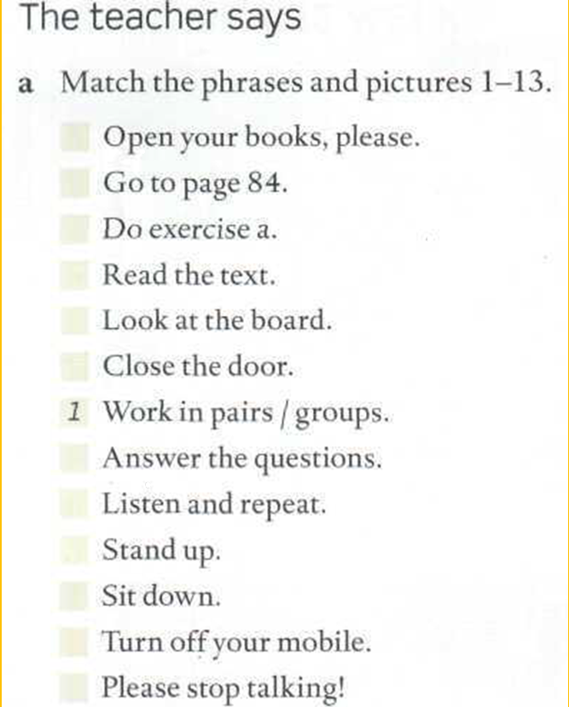
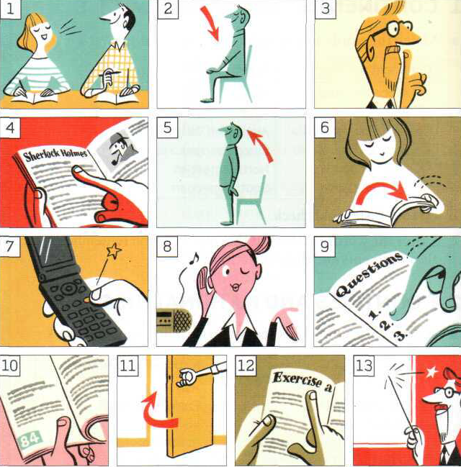
Page
150
Number, repeat, memorize and say in a loud voice (many times!)

Slide 3
…book
…down
…up
…talking
…page 20
…your mobile
…and repeat
…the questions
…in pairs/in groups
…the door / the window
…the board
…the text
…exercise

Slide 4
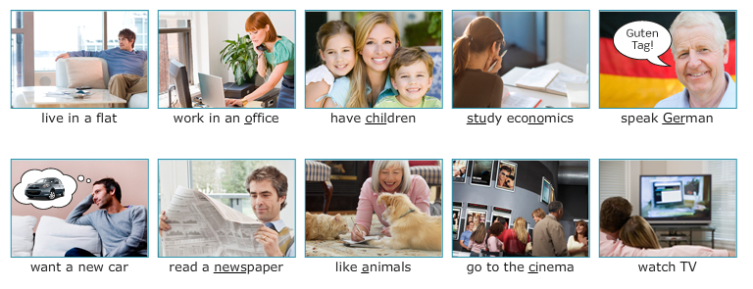

Slide 5
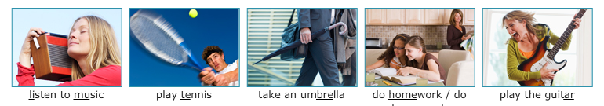
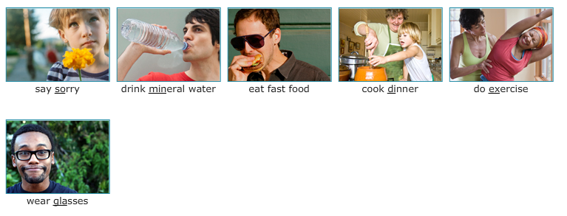

Slide 6
…in a flat …children …economics
…in an office …German …a new car
…a newspaper …animals …to the cinema
…TV …to music …tennis
…an umbrella …homework …housework
…the guitar …the piano …sorry
…mineral water …wine …fast food
…dinner …exercise …glasses
…shorts …make-up

Slide 7
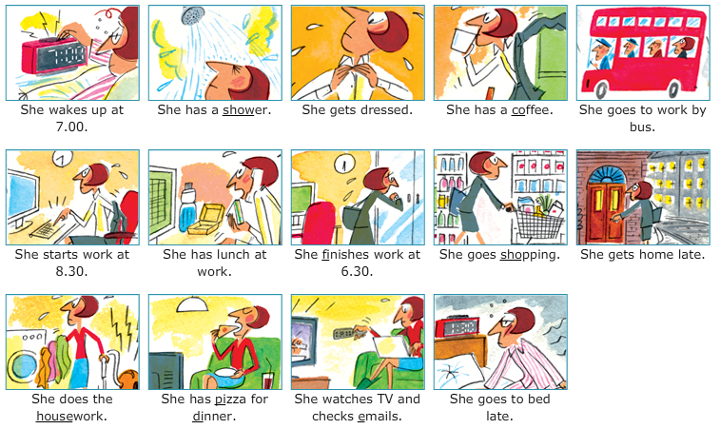

Slide 8
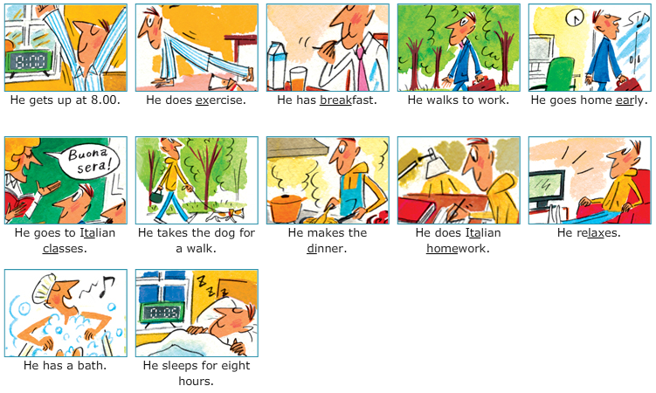
1.20

Slide 9
… up …up … dressed
…a shower/a bath …a sandwich …a coffee
…to work by bus …lunch …breakfast
…dinner …work …work
…shopping …home …home
…housework …homework …exercise
…TV …to work …to classes
…emails …to bed late …to bed early
…the dog for a walk …for 8 hours

Slide 10
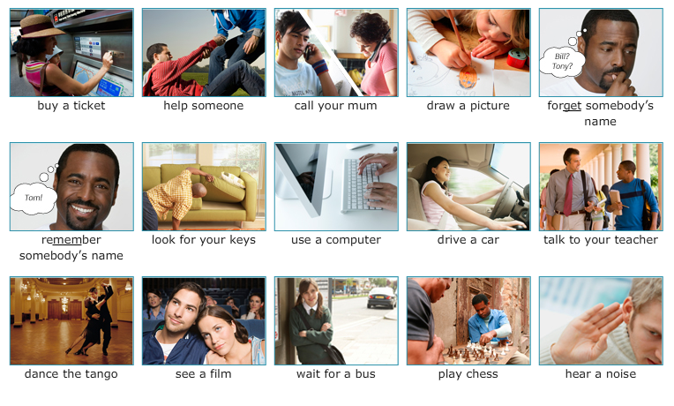
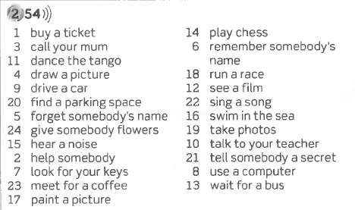
More verb phrases

Slide 11
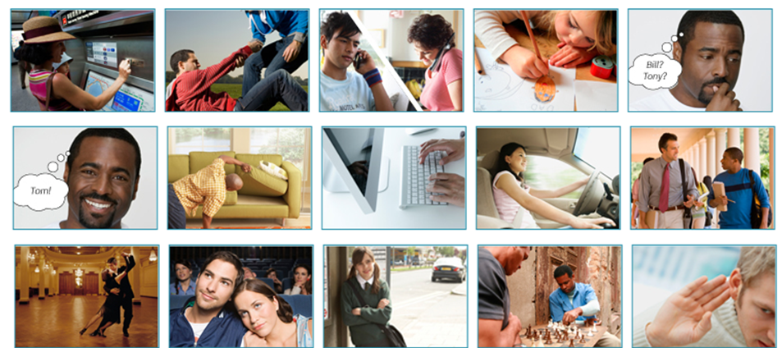

Slide 12
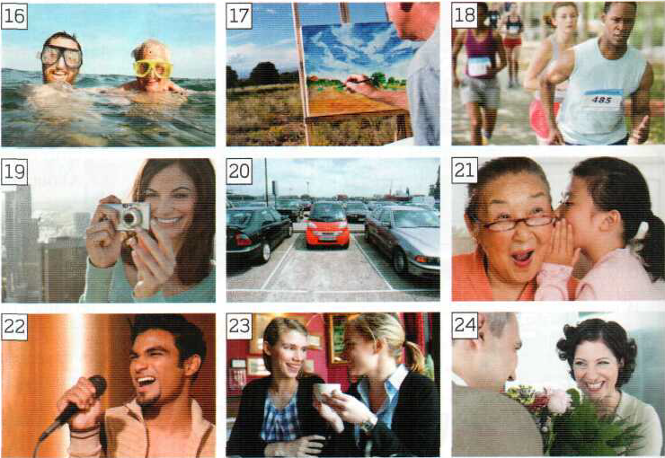

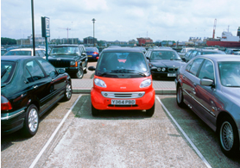
More verb phrases

Slide 13
More verb phrases

Slide 15
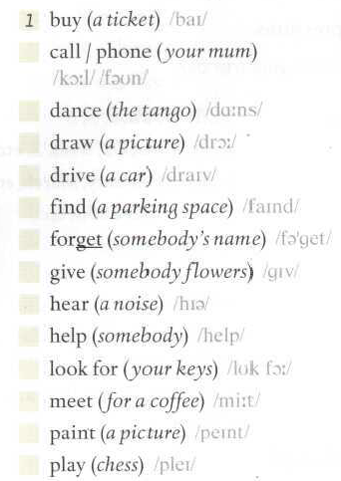
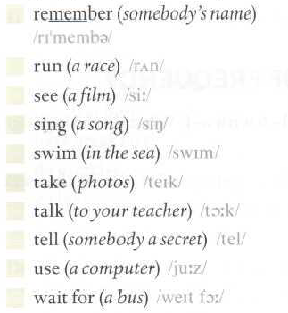
More verb phrases

Slide 16
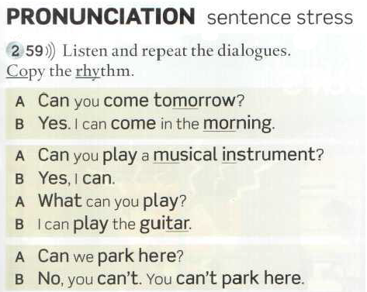
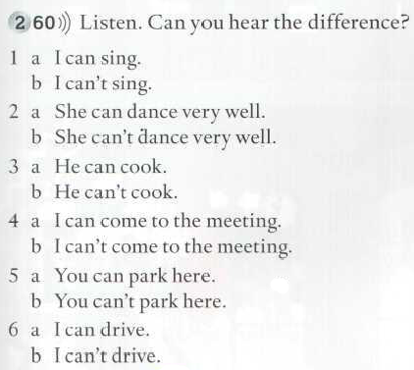
CAN / CAN’T
Which can you hear, a or b?

Slide 17
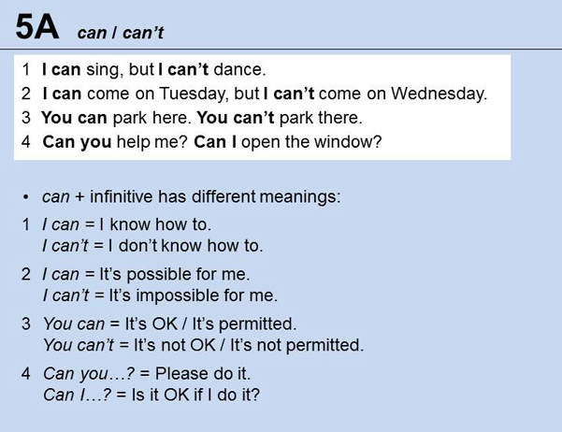
CAN / CAN´T

Slide 18
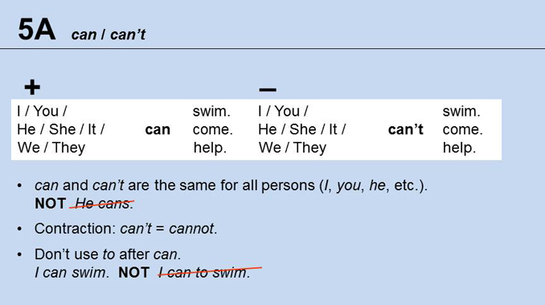

Slide 19
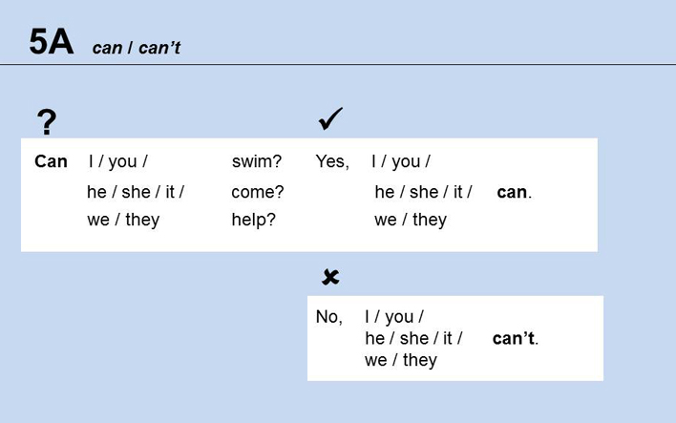

Slide 20


When someone has the X factor, that person has a quality that you cannot describe that makes someone very special: A singer who has the X factor, has exceptional qualities, abilities or talent.

Slide 21
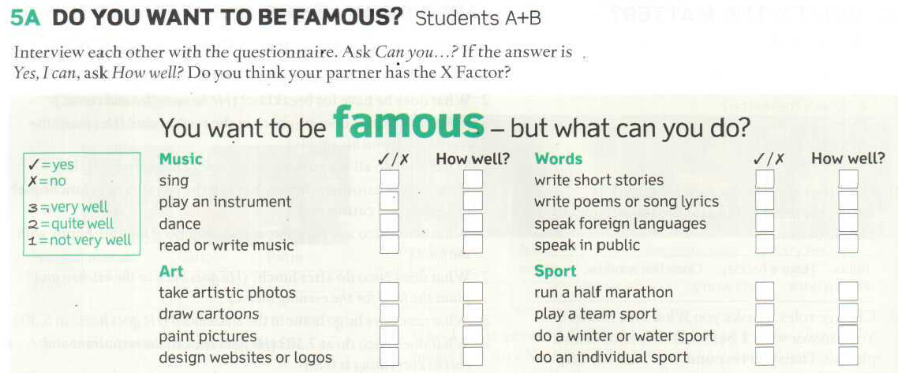
Do you want to be famous?
Does he or she have the x Factor?

Slide 22
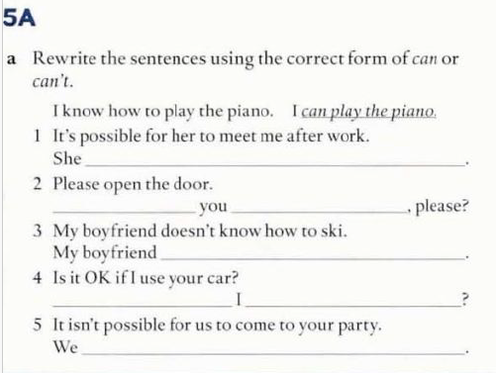
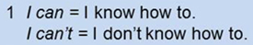
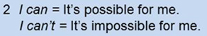
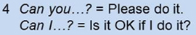
can meet me after work.
Can
open the door
can’t ski.
Can
use your car
can’t come to your party.

Slide 23
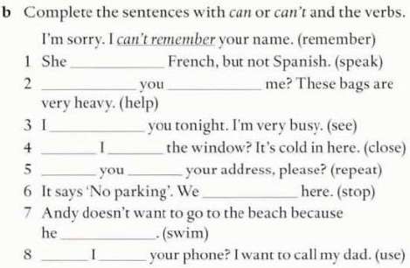
can speak
Can
help
can’t see
Can
close
Can
repeat
can’t stop
can’t swim
Can
use

